Slide 1

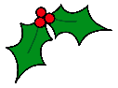





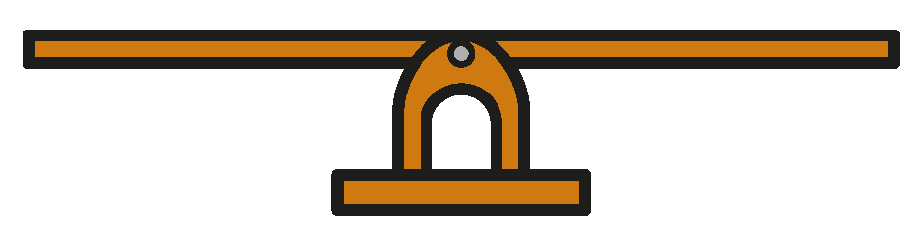
ADVENT – Day 1
These scales are balanced.
Find the mass of each present.
2g
1g
10g
20g

Slide 2










ADVENT – Day 1
These scales are balanced.
Find the mass of each present.
2g
1g
10g
20g
We know:
We now know:
As a bar model:
$=$ 20 g $+$ 2 g $+$ 1 g
23 g
$$+$$
10g
$$=$$
46 g + 10 g
$=$ 23 g
$$+$$
$$=$$
23 g
23 g
Therefore:
10g
56 g
46 g
$=$ 23 g $+$ 23 g
Therefore:
$=$ 46 g
46 g
10 g
$$=$$
56 g
$=$ 46 g
56 g

Slide 3
ADVENT – Day 1
Here we address the misconception that objects of equal size will have equal mass.
We know children like to work from left to right. This question requires us not to begin on the left, or the middle, but the right.
We can also emphasise the meaning of the equality symbol and show
56 g is equal to the yellow present or the yellow present is equal to 56 g.

Slide 4
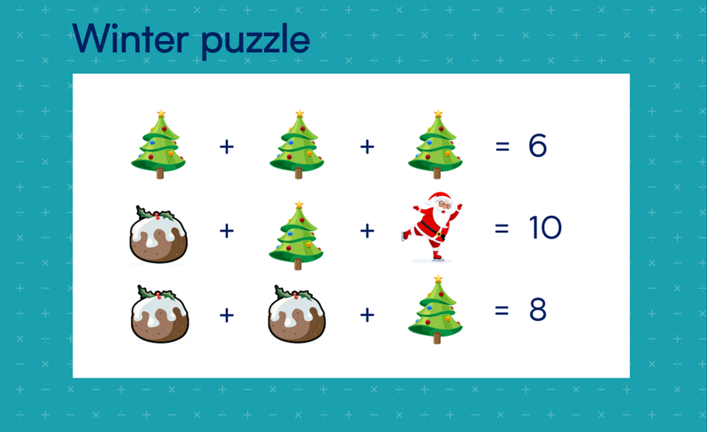
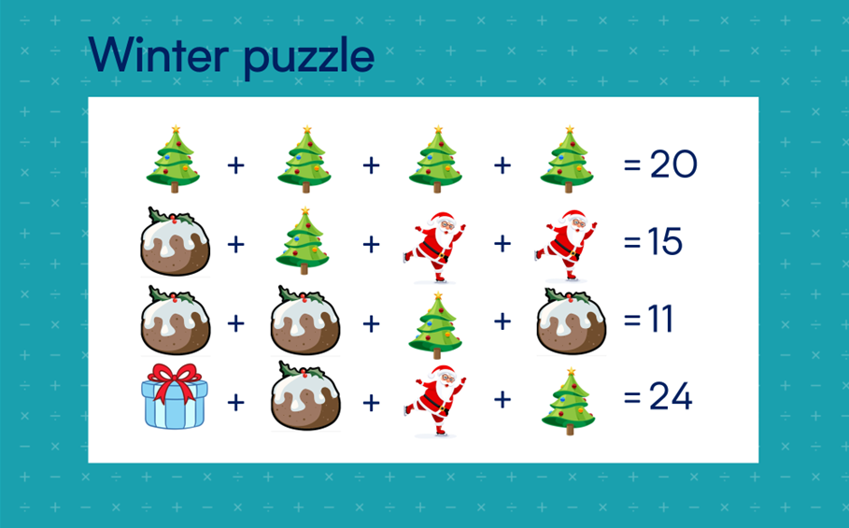
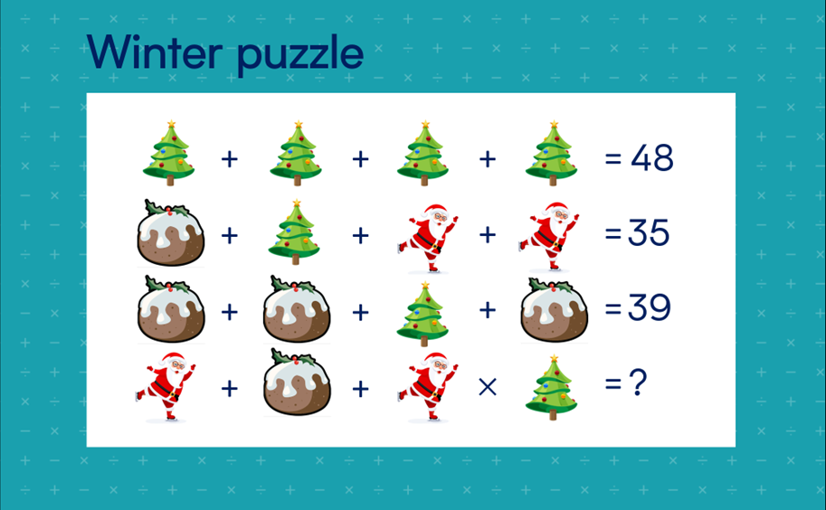
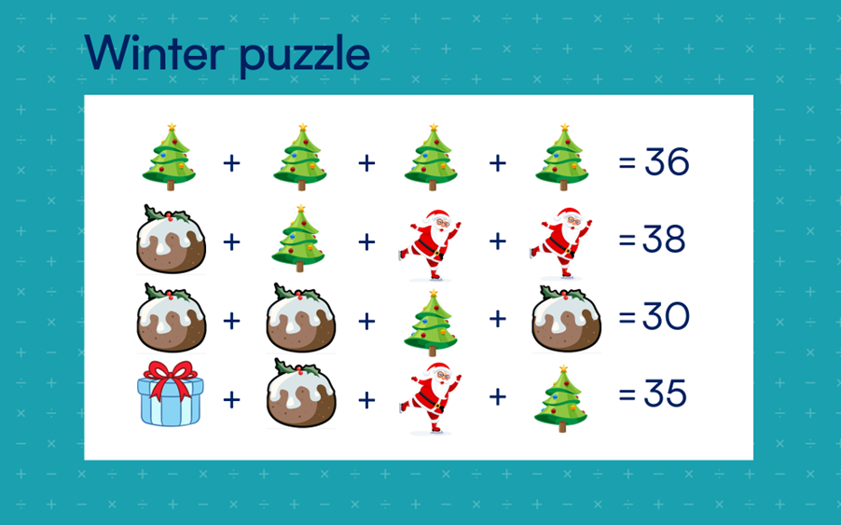
ADVENT – Day 2
Can you solve these winter puzzles?

Slide 5
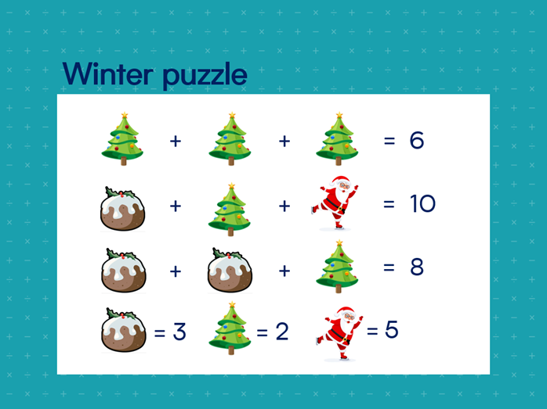
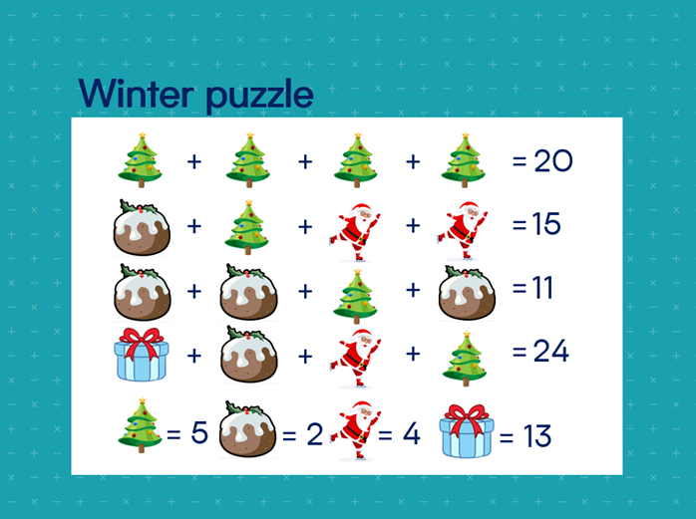
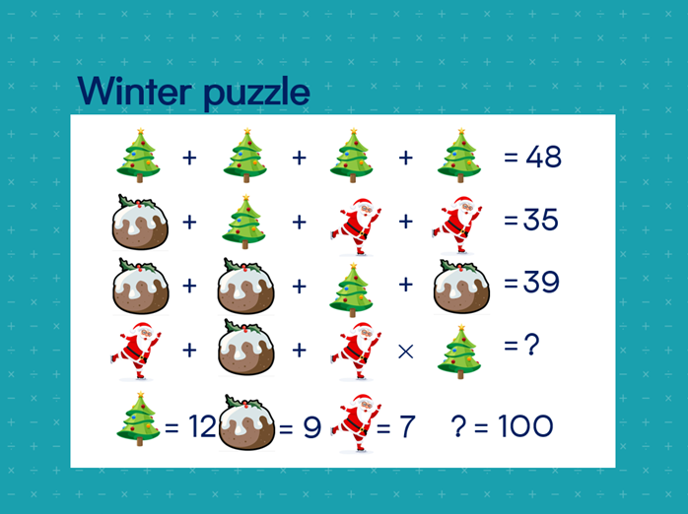
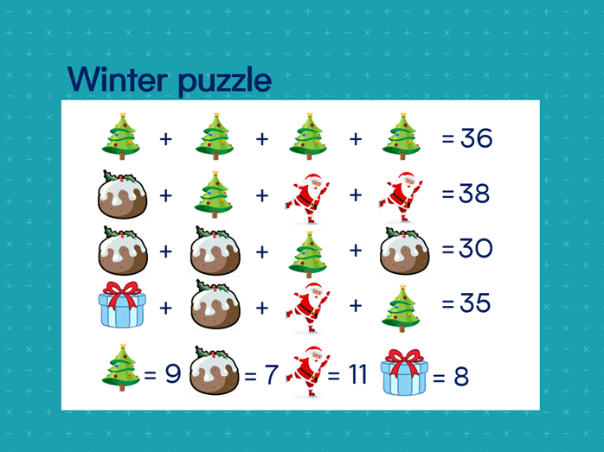
ADVENT – Day 2
Can you solve these winter puzzles?

Slide 6
ADVENT – Day 2
Puzzles like this allow the children to get stuck.
We should celebrate this and allow all children to get stuck.
We should be ready with a scaffold or a strategy to enable them to access the problem when they need it.
A great first question here is, “What do you know?”

Slide 7


ADVENT – Day 3
Santa is buying apples and carrots for his reindeer.
He buys 5 times as many carrots as apples.
He buys 6 apples.
How many carrots does Santa buy?
Notes:
KS1

Slide 8
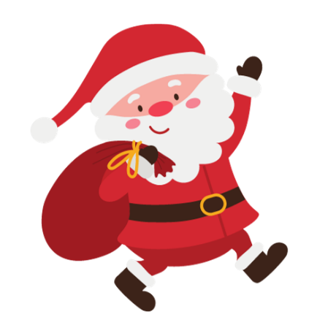
ADVENT – Day 3
Santa is buying apples and carrots for his reindeer.
He buys 5 times as many carrots as apples.
He buys 6 apples.
How many carrots does Santa buy?
We know:
Santa buys 6 apples
Santa buys 5 times as many carrots as apples
Therefore:
A
C
We know:
6
6 $×$ 5 $=$ 30
6 | 6 | 6 | 6 | 6
Santa buys 30 carrots.

Slide 9
ADVENT – Day 3
A bar model may be something you encourage children to draw, or provide as a scaffold.

Slide 10

ADVENT – Day 4
Santa is packing presents into his sack.
If he puts 16 presents in each sack and has 3 sacks in total, how many presents does Santa have altogether?
Which is your preferred method and why?
A
B
T | O
Double 16 = 32
32 + 16 = 48
Notes:
LKS2

Slide 11
ADVENT – Day 4
Santa is packing presents into his sack.
If he puts 16 presents in each sack and has 3 sacks in total, how many presents does Santa have altogether?
Both answers are correct.
A
B
T | O
Double 16 = 32
32 + 16 = 48
Notes:
LKS2

Slide 12
ADVENT – Day 4
This problem encourages children to explore multiple methods and give justification for using a specific approach.
This encourages children to not focus on the answer but instead discuss their thinking.

Slide 13
ADVENT – Day 5
Use symmetry to complete the picture of Santa’s grotto.
Notes:
KS1

Slide 14
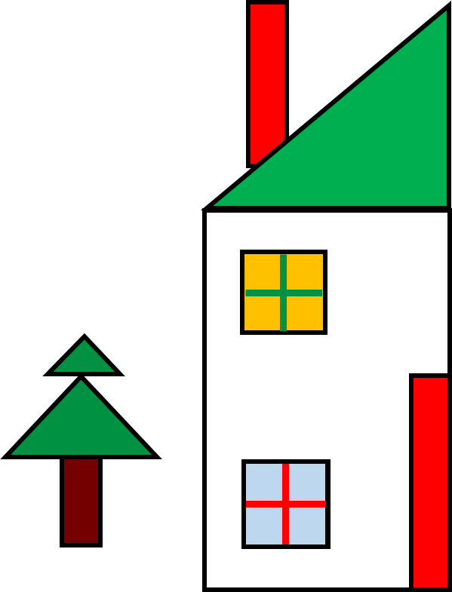
ADVENT – Day 5
Use symmetry to complete the picture of Santa’s grotto.
Notes:
KS1

Slide 15
ADVENT – Day 5
Children may use their knowledge of 2D shapes to enable them to access the question.
A useful checking strategy is to demarcate vertices and find the distance from the mirror line.

Slide 16


ADVENT – Day 6
Mrs Claus has baked a batch of 24 delicious cookies for the workshop elves. She wants to share them equally between 6 elves.
Which image represents this problem?
Explain how you know.
A
B
Notes:
KS1

Slide 17
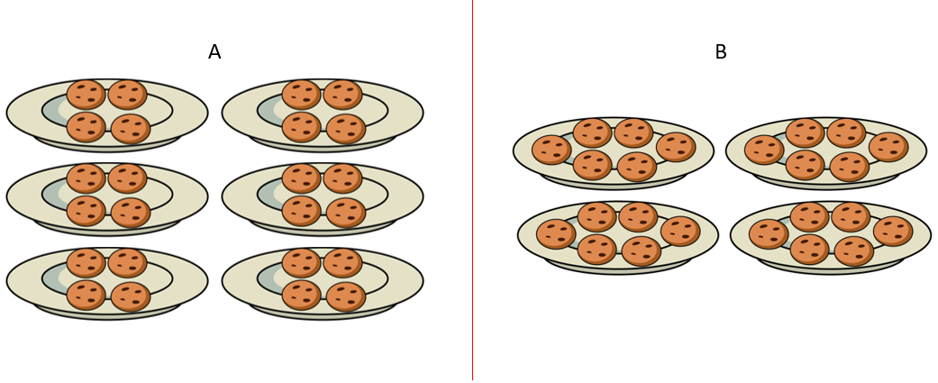
ADVENT – Day 6
Mrs Claus has baked a batch of 24 delicious cookies for the workshop elves. She wants to share them equally between 6 elves.
Which image represents this problem?
Explain how you know.
✓
X
Representation A shows 24 cookies being shared equally between 6 plates.
Representation B shows 24 cookies being put into 4 equal groups of 6.

Slide 18
ADVENT – Day 6
This problem explores two structures of division (sharing and grouping).
It is important children read and interpret the context of this question in order to match it to the correct representation.
Manipulatives such as counters may be useful to model each structure.

Slide 19
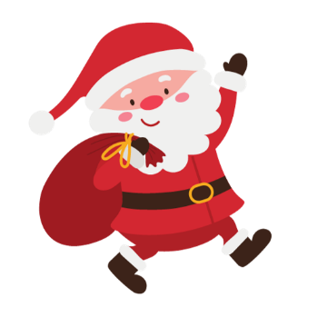
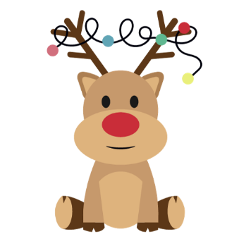
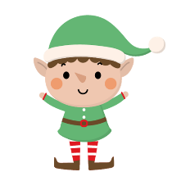
ADVENT – Day 7
Santa, his 9 reindeer and 4 elves land on the roof of a house.
How many legs are on the roof of the house?
Notes:
LKS2

Slide 20
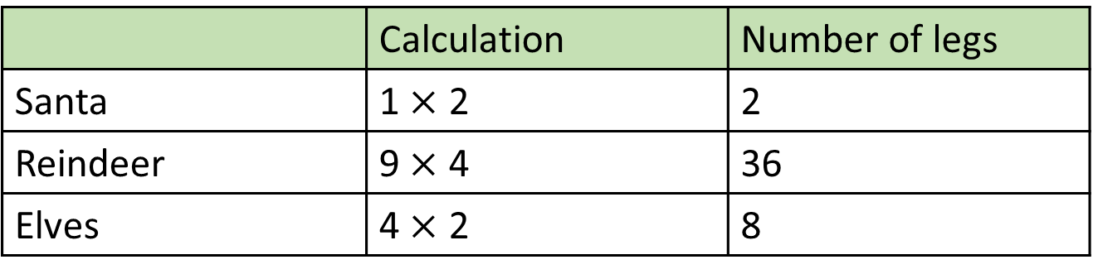
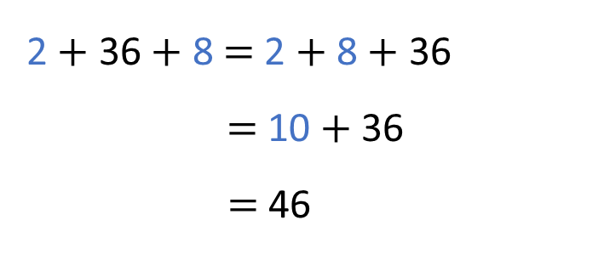
ADVENT – Day 7
Santa, his 9 reindeer and 4 elves land on the roof of a house.
How many legs are on the roof of the house?
 | Calculation | Number of legs
Santa | 1 $×$ 2 | 2
Reindeer | 9 $×$ 4 | 36
Elves | 4 $×$ 2 | 8
2 $+$ 36 $+$ 8 $=$ 2 $+$ 8 $+$ 36
$=$ 10 $+$36
$=$ 46
There are 46 legs on the roof of the house.

Slide 21
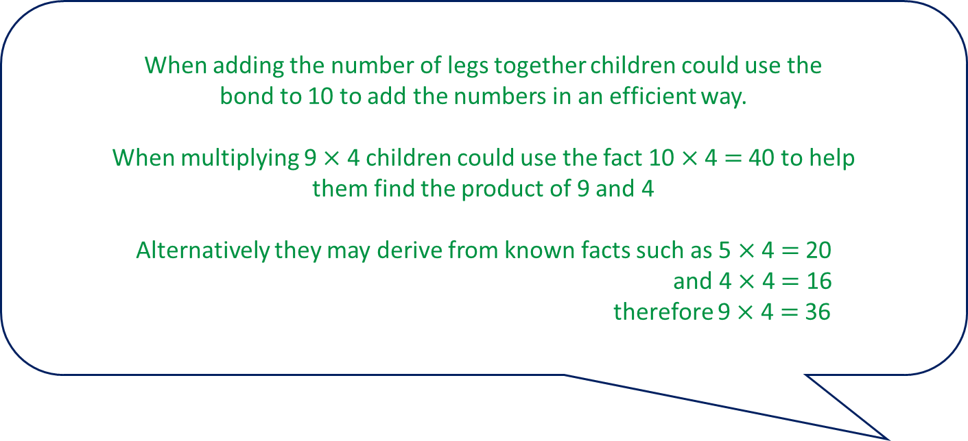
ADVENT – Day 7
When adding the number of legs together children could use the
bond to 10 to add the numbers in an efficient way.
When multiplying 9 $×$ 4 children could use the fact 10 $×$ 4 $=$ 40 to help
them find the product of 9 and 4
Alternatively they may derive from known facts such as 5 $×$ 4 $=$ 20
and 4 $×$ 4 $=$ 16
therefore 9 $×$ 4 $=$ 36

Slide 22

ADVENT – Day 8
Calculate the fraction of the colours on each present.
Red:
Green:
White:
Red:
Green:
White:
Red:
Green:
White:
Notes:
UKS2

Slide 23









ADVENT – Day 8
Calculate the fraction of the colours on each present.
Red:
Green:
White:
Red:
Green:
White:
Red:
Green:
White:
$\frac{1}{4}$
$\frac{1}{2}$
$\frac{1}{4}$
$\frac{1}{8}$
$\frac{1}{2}$
$\frac{3}{8}$
$\frac{1}{4}$
$\frac{3}{8}$
$\frac{3}{8}$

Slide 24
ADVENT – Day 8
The whole has been divided into __ equal parts.
___ has been shaded (colour).
This question encourages the children to reason. If the red part is difficult to calculate, they can use their knowledge of the white and green parts to find the red part. It could be helpful to encourage children to visualise moving parts around to combine sections that are the same colour.

Slide 25

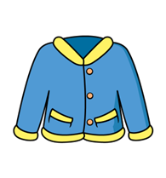



ADVENT – Day 9
In a shop, each item has £5 off.
Tom has £30 to spend.
He buys 2 items.
What could Tom buy?
£10
£32
£8
£16
£22
Notes:
LKS2

Slide 26
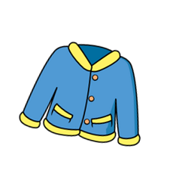









ADVENT – Day 9
In a shop, each item has £5 off.
Tom has £30 to spend.
He buys 2 items.
What could Tom buy?
£10
£32
£8
£16
£22
Hat price $=$ 10 $−$ 5 $=$ £5
Coat price $=$ 32 $−$ 5 $=$ £27
Socks price $=$ 8 $−$ 5 $=$ £3
Gloves price $=$ 16 $−$ 5 $=$ £11
Boots price $=$ 22 $−$ 5 $=$ £17
Total cost £30
Total cost £28
Total cost £16
Total cost £22
Total cost £14
Total cost £20
Total cost £8

Slide 27
ADVENT – Day 9
Spotting connections allows children to reason about future
calculations and improve efficiency and understanding.
Here our two connected calculations are: 22 – 5 and 32 – 5
Manipulatives could be used alongside the calculations to
support children’s understanding of the concept.

Slide 28


ADVENT – Day 10
On Christmas Eve, Santa travels 12,500 km.
He flies at a speed of 1,000 km per hour.
After travelling for 4 hours and 45 minutes, how much further does he have to fly?
Notes:
UKS2

Slide 29



ADVENT – Day 10
On Christmas Eve, Santa travels 12,500 km.
He flies at a speed of 1,000 km per hour.
After travelling for 4 hours and 45 minutes, how much further does he have to fly?
45 minutes $=$ 0.75 hours
TTh | Th | H | T | O | Tth | Hth | Thth
Santa has travelled for 4.75 hours
4.75 $×$ 1,000 $=$
4,750 km travelled
12,500 $−$ 4,750 $=$
7,750 km left to travel
12,500
4,750 | ?
7,750

Slide 30
ADVENT – Day 10
Children apply their knowledge of fractions of amounts and find that 45 is three-quarters of 60, and therefore 45 minutes is 0.75 hours, in order to determine the total time travelled in hours.

Slide 31


ADVENT – Day 11
There are 9 reindeer pulling the sleigh.
On each reindeer’s harness there are 3 bells.
Santa’s hat has 1 bell.
Each elf has 1 bell on each shoe.
The total number of bells on the sleigh is a multiple of 10
There is more than 1 but fewer than 10 elves.
How many elves are there travelling with Santa?
Notes:
LKS2

Slide 32

ADVENT – Day 11
There are 9 reindeer pulling the sleigh.
On each reindeer’s harness there are 3 bells.
Santa’s hat has 1 bell.
Each elf has 1 bell on each shoe.
The total number of bells on the sleigh is a multiple of 10
There is more than 1 but fewer than 10 elves.
How many elves are there travelling with Santa?
Bells on reindeer: 9 $×$ 3 $=$ 27
Bells on Santa: 1
Bells on reindeer | Bells on Santa | Number of elves | Bells on elves | Total bells
27 | 1 | 1 | 2 | 30
27 | 1 | 2 | 4 | 32
27 | 1 | 3 | 6 | 34
27 | 1 | 4 | 8 | 36
27 | 1 | 5 | 10 | 38
27 | 1 | 6 | 12 | 40

Slide 33
ADVENT – Day 11
Encourage children to work systematically to present the number of elves.
If children are struggling, provide a table which has been partly completed along with counters to represent the bells.

Slide 34



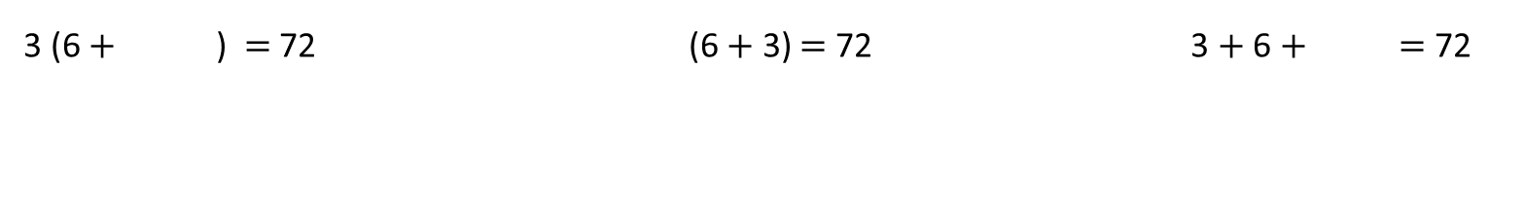
ADVENT – Day 12
Find the value of Santa, the reindeer and the snowman.
3 (6 $+$ ) $=$ 72 (6 $+$ 3) $=$ 72 3 $+$ 6 $+$ $=$ 72
Notes:
UKS2

Slide 35












ADVENT – Day 12
Find the value of Santa, the reindeer and the snowman.
3 (6 $+$ ) $=$ 72 (6 $+$ 3) $=$ 72 3 $+$ 6 $+$ $=$ 72
3
72
72
$$×$$
$=$ 72
3
6
72 $−$ 18 $=$ 3 $×$
$×$ 9 $=$ 72
72 $−$ 9 $=$
54 $=$ 3 $×$
$=$ 18
$=$ 8
$=$ 63

Slide 36
ADVENT – Day 12
The numbers are deliberately the same, encouraging children to consider the order in which they complete each calculation.
Using counters, or a bar model, to represent each calculation supports children to recognise which operation is needed to find the missing value.

Slide 37
ADVENT – Day 13
Holly the elf helps Santa by wrapping presents.
She wraps one present in 3 minutes.
Can Holly wrap 25 presents in an hour?
Explain how you know.
Notes:
UKS2

Slide 38

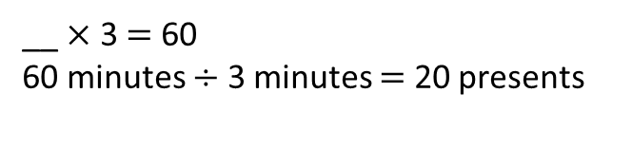
ADVENT – Day 13
Holly the elf helps Santa by wrapping presents.
She wraps one present in 3 minutes.
Can Holly wrap 25 presents in an hour?
Explain how you know.
takes 3 minutes to wrap
__ $×$ 3 $=$ 60
60 minutes $÷$ 3 minutes $=$ 20 presents
Holly can only wrap 20 presents in an hour.
25 presents would take her longer than an hour.
Notes:
UKS2

Slide 39
ADVENT – Day 13
This problem encourages children to use the inverse operation to solve the problem.
It also encourages them to check how reasonable their answer is in the context of the question.

Slide 40




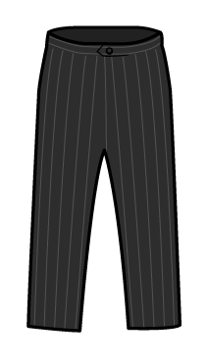


ADVENT – Day 14
An elf has £20 to spend on an outfit to wear on Christmas Day.
They buy at least two items.
Each item is different.
Which items could they buy?
Find as many different combinations as you can.
£10
£17
£5 and 50p
£12
£11
£2 and 50p
Notes:
LKS2

Slide 41
ADVENT – Day 14
An elf has £20 to spend on an outfit to wear on Christmas Day.
They buy at least two items.
Each item is different.
Which items could they buy?
Find as many different combinations as you can.
T-shirt | Trousers | Cap | Gloves | Scarf | Socks | Total
✓ |  |  |  |  | ✓ | £12 and 50p
✓ |  |  | ✓ |  | ✓ | £18
✓ |  |  | ✓ |  |  | £15 and 50p
 | ✓ |  | ✓ |  |  | £17 and 50p
 | ✓ |  | ✓ |  | ✓ | £20
 | ✓ |  |  |  | ✓ | £14 and 50p
 |  | ✓ |  |  | ✓ | £19 and 50p
 |  |  | ✓ | ✓ |  | £16 and 50p
 |  |  | ✓ |  | ✓ | £8
 |  |  |  | ✓ | ✓ | £13 and 50p
 |  |  | ✓ | ✓ | ✓ | £19
There are 11 possible combinations.

Slide 42
ADVENT – Day 14
Being systematic and children organising their findings is key here.
A table could be a clear way of organising this.

Slide 43
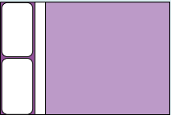
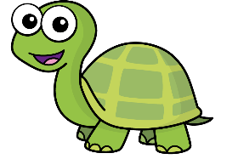



ADVENT – Day 15
Ron is putting Christmas lights all the way around his bedroom.
Is Tiny correct? Explain your reasons.
2.5 m
Ron needs 14 metres of Christmas lights.
3 m
1.5 m
4 m

Slide 44
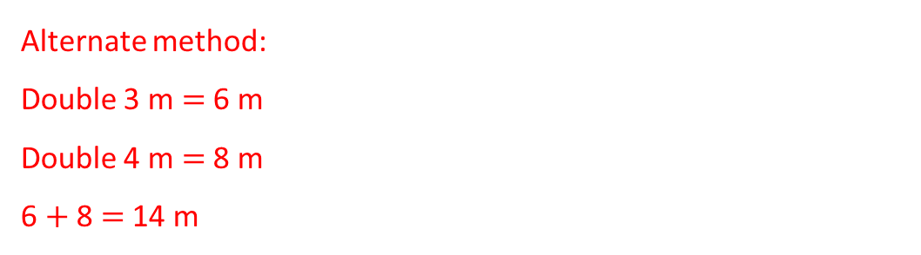
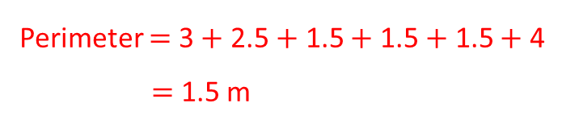
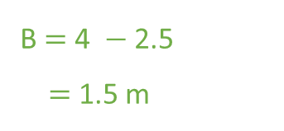
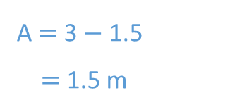
ADVENT – Day 15
Ron is putting Christmas lights all the way around his bedroom.
Is Tiny correct? Explain your reasons.
2.5 m
Ron needs 14 metres of Christmas lights.
3 m
1.5 m
4 m
2.5 m
2.5 m
Alternate method:
Double 3 m $=$ 6 m
Double 4 m $=$ 8 m
6 $+$ 8 $=$ 14 m
A
1.5 m
B
1.5 m
3 m
3 m
1.5 m
1.5 m
4 m
4 m
A $=$ 3 $−$ 1.5
$=$ 1.5 m
B $=$ 4 $−$ 2.5
$=$ 1.5 m
Tiny is correct.
Tiny has calculated the missing lengths.
Ron needs 14 metres of Christmas lights.
Perimeter $=$ 3 $+$ 2.5 $+$ 1.5 $+$ 1.5 $+$ 1.5 $+$ 4
$=$ 1.5 m

Slide 45
ADVENT – Day 15
Here we address the misconception that when finding the perimeter of a compound shape you just add the lengths that are given.
This question also lends itself to exploring different methods.
Rather than finding all the lengths and having to add decimals, children could simply double 4 m and double 3 m and add them together.

Slide 46
ADVENT – Day 16
8 Christmas presents have a mean mass of 1.3 kg.
Santa delivers a present with mass 0.4 kg to Jack.
He also delivers a present of mass 1.6 kg to Sam.
What is the total mass of the presents left?

Slide 47



ADVENT – Day 16
8 Christmas presents have a mean mass of 1.3 kg.
Santa delivers a present with mass 0.4 kg to Jack.
He also delivers a present of mass 1.6 kg to Sam.
What is the total mass of the presents left?
10.4 kg
Jack
Sam
0.4 kg
1.6 kg
8.4 kg
Mean $=$1.3 kg
1.3 $×$ 8 $=$ 10.4
10.4 $−$ (0.4 $+$ 1.6) $=$ 8.4
Total mass of all presents $=$10.4 kg
Total mass of the presents left $=$ 8.4 kg

Slide 48
ADVENT – Day 16
Representing this question visually can help students make connections with the information given and what they can work out from that.
Facilitate discussions with students using questions such as, “How do we calculate the mean?” and, “How could we find the total from that?”

