Slide 1

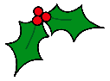

ADVENT – Day 1
Elves need pieces of ribbon that are 1 $\frac{3}{4}$m long to wrap presents. A reel has a length of ribbon that is 6 m long.
How many 1 $\frac{3}{4}$m pieces of ribbon can be cut from a reel?

Slide 2
ADVENT – Day 1
Elves need pieces of ribbon that are 1 $\frac{3}{4}$m long to wrap presents. A reel has a length of ribbon that is 6 m long.
How many 1 $\frac{3}{4}$m pieces of ribbon can be cut from a reel?
1 $\frac{3}{4}=\frac{7}{4}$
6 $÷\frac{7}{4}$
1 $\frac{3}{4}=\frac{7}{4}$
6 $÷\frac{7}{4}$
$\frac{6}{1}÷\frac{7}{4}=\frac{6}{1}×\frac{4}{7}=\frac{24}{7}$
$\frac{24}{7}=$3 $\frac{3}{7}$
3 pieces of ribbon.

Slide 3
ADVENT – Day 1
The abstract calculation can be tricky for some students to understand.
Using bar models can help students visualise how many $\frac{7}{4}$ ‘go into’ 6.
Highlight the importance of converting to an improper fraction first as often students will try and divide the integer and fraction separately.

Slide 4
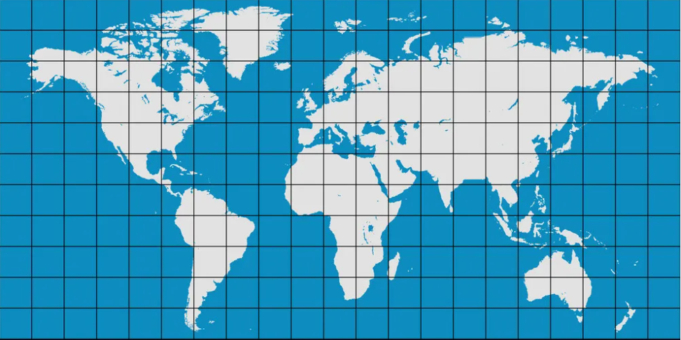
ADVENT – Day 2
Here is map of some locations that Santa and his reindeer have to visit to deliver presents.
J
L
C
E
A
U
B
M
G
D
R
S
N
T
H
F
Santa starts from one of the letters and moves to a new location after each move.
He travels:
4 squares West
2 squares South
4 squares East
2 squares South
Which letters did Santa and his reindeer visit?

Slide 5
ADVENT – Day 2
Here is map of some locations that Santa and his reindeer have to visit to deliver presents.
J
L
C
E
A
U
B
M
G
D
R
S
N
T
H
F
Santa starts from one of the letters and moves to a new location after each move.
He travels:
4 squares West
2 squares South
4 squares East
2 squares South
Which letters did Santa and his reindeer visit? CLAUS

Slide 6
ADVENT – Day 2
Sometimes Students find this type of problem difficult to start. Trial and error is a great method, to get started, encourage students to just have a go.
Alternatively, students could consider the whole journey and recognise that they are looking for the start and finish to be on a vertical line with 4 moves between them.

Slide 7
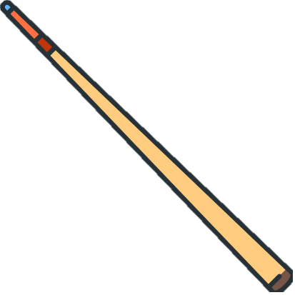

ADVENT – Day 3
Mo needs to wrap this gift for Ron.
The wrapping paper measures 1 m by 50 cm.
Will he have enough wrapping paper?
not to scale
105 cm
3 cm
Wrapping paper
50 cm
1 m

Slide 8
ADVENT – Day 3
Mo needs to wrap this gift for Ron.
The wrapping paper measures 1 m by 50 cm.
Will he have enough wrapping paper?
not to scale
105 cm
3 cm
Using Pythagoras’ theorem
$$a2 + b2 = c2$$
$$\text{50}2 + \text{100}2 = c2$$
$$c2 = \text{2500 }+ \text{10,000}$$
$$c2 = \text{12,500}$$
$$c= \sqrt{\text{12500}}$$
$$c=\text{111.803}$$
$$\text{105 }<\text{ 111.803 }$$
$∴$ Mo will have enough wrapping paper.
50 cm
100 cm

Slide 9
ADVENT – Day 3
This is a great real-life example of how Pythagoras can be used to prove Mo has enough wrapping paper.
Some students will think Mo doesn’t have enough, because the longest side is only 100 cm. Pushing students to think more creatively is a great way to stretch their critical thinking skills.

Slide 10
ADVENT – Day 4
338 people take part in a Christmas raffle.
$\frac{\text{2}}{\text{3}}$ of the adults win a prize.
$\frac{\text{1}}{\text{5}}$ of the children win a prize.
The same number of prizes are won by the adults and children.
How many children win a prize?

Slide 11
ADVENT – Day 4
338 people take part in a Christmas raffle.
$\frac{\text{2}}{\text{3}}$ of the adults win a prize.
$\frac{\text{1}}{\text{5}}$ of the children win a prize.
The same number of prizes are won by the adults and children.
How many children win a prize?
Adults
338
Children
26
26
52
338 $÷$ 13 $=$26
26 $×$ 2 $=$52
52 children win a prize.

Slide 12
ADVENT – Day 4
Drawing a bar model to represent fractions is an excellent way to visualise how to solve the problem.
We can see the connection between $\frac{2}{3}$ and $\frac{1}{5}$ to then determine how many equal parts there are.
For your quick graspers: “What else can you find out?”

Slide 13

ADVENT – Day 5
Alex and Amir are setting up the school hall for the Christmas pantomime.
They need to set out the chairs.
Alex arranged the chairs in rows of 18 and there were 3 remainder.
Amir rearranged them into rows of 15 and there were no remainder.
How many chairs were there in the town hall?

Slide 14
ADVENT – Day 5
Alex and Amir are setting up the school hall for the Christmas pantomime.
They need to set out the chairs.
Alex arranged the chairs in rows of 18 and there were 3 remainder.
Amir rearranged them into rows of 15 and there were no remainder.
How many chairs were there in the town hall?
Multiples of 18
Multiples of 15
18 $+$ 3
15
36 $+$ 3
30
54 $+$ 3
45
72 $+$ 3
60
90 $+$ 3
75
108 $+$ 3
90
Alex arranged the chairs into 4 rows of 18 with 3 remaining.
Amir arranged the rows into 5 rows of 15.
There were 75 chairs in total.

Slide 15
ADVENT – Day 5
This is not an obvious Lowest Common Multiple problem with the
remainder to consider.
Listing the 15 and 18 times tables is a great starting point. To scaffold this question, the use of a calculator may help with the more challenging times tables.

Slide 16
ADVENT – Day 6
In a group of 200 elves
176 elves said they like candy canes.
138 elves said they like marshmallows.
17 elves did not like either.
Find the probability of picking an elf at random that only likes candy canes.
candy canes
marshmallows

Slide 17
ADVENT – Day 6
In a group of 200 elves
176 elves said they like candy canes.
138 elves said they like marshmallows.
17 elves did not like either.
Find the probability of picking an elf at random that only likes candy canes.
200 $−$17 $=$183 elves left to sort
candy canes
marshmallows
138 $+$176 $=$ 314 elves
45
131
7
314 $−$ 183 $=$131
176 $−$131 $=$45
17
138 $−$131 $=$7
$P$(elves only liking candy canes) = $\frac{45}{200}$ = $\frac{9}{40}$

Slide 18
ADVENT – Day 6
It can often be useful to direct students to refer to the total, and to notice that 176 $+$ 138 is greater than 200
Encourage students to find the intersection first, we do this by determining how many extra elves there are compared to those left to sort. This determines how many elves must lie in both categories.

Slide 19
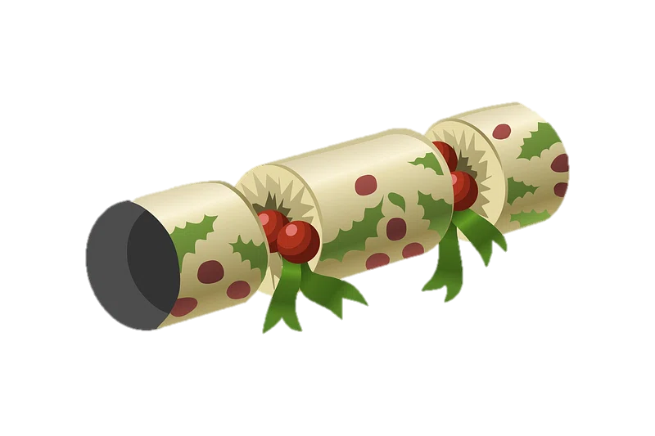
ADVENT – Day 7
Christmas crackers are sold in boxes of 6, 12 and 24
a) Which box of Christmas crackers is the best value for money?
Dexter needs 60 crackers.
b) What combination of boxes should Dexter choose to spend the least amount of money?
6 crackers
£7.99
12 crackers
£16
24 crackers
£31.50

Slide 20









ADVENT – Day 7
Christmas crackers are sold in boxes of 6, 12 and 24
a) Which box of Christmas crackers is the best value for money?
Dexter needs 60 crackers.
b) What combination of boxes should Dexter choose to spend the least amount of money?
24 crackers for £31.50
6 crackers $=$ £7.99
6 crackers
£7.99
$×$ 4
$×$ 4
24 crackers $=$ £31.96
12 crackers
£16
12 crackers $=$ £16
$×$ 2
$×$ 2
24 crackers $=$£32
24 crackers
£31.50
24 crackers $=$ £31.50
best value

Slide 21

ADVENT – Day 7
Christmas crackers are sold in boxes of 6, 12 and 24
a) Which box of Christmas crackers is the best value for money?
Dexter needs 60 crackers.
b) What combination of boxes should Dexter choose to spend the least amount of money?
24 crackers for £31.50
2 lots of 24 crackers and 2 lots of 6 crackers
6 crackers
£7.99
£31.50
24 crackers
£31.50
24 crackers
12 crackers
£16
£7.99
6 crackers
£7.99
6 crackers
$$+$$
£78.98
60 crackers
24 crackers
£31.50

Slide 22
ADVENT – Day 7
Best buy questions can provide excellent discussion points with students.
There are a number of ways students may find the best value.
Most commonly students will find the unit value and do not always spot that each option can be scaled up to a multiple of each amount.
A great first step is to estimate. Students then consider what a reasonable value is before performing their calculation.

Slide 23
ADVENT – Day 8
The Christmas tree is made from two identical trapeziums, a triangle, a rectangle and a square.
Work out the total area of the Christmas tree.
Not to scale
70 cm
35 cm
50 cm
160 cm
45 cm
25 cm
25 cm
15 cm
40 cm

Slide 24













ADVENT – Day 8
The Christmas tree is made from two identical trapeziums, a triangle, a rectangle and a square.
Work out the total area of the Christmas tree.
Not to scale
35 $×$ 70 $=$ 2450
70 cm
35 cm
2450 $÷$ 2 $=$ 1225
$=$ 1225 cm²
70 cm
35 cm
50 cm
50 $+$ 70 $=$ 120
$=$ 2700 cm²
45 cm
120 $÷$ 2 $=$ 60
50 cm
160 cm
60 $×$ 45 $=$ 2700
45 cm
70 cm
$=$ 2700 cm²
20 cm
160 $−$ 35 $−$ 45 $−$ 45 $−$ 15 $=$ 20
25 cm
25 cm
$=$ 400 cm²
20 cm
20 $×$ 20 $=$ 400
15 cm
$=$ 600 cm²
40 cm
15 cm
15 $×$ 40 $=$ 600
Total area $=$ 7625 cm²
40 cm

Slide 25
ADVENT – Day 8
Encourage students to break compound shapes up into shapes they are more familiar with. Separating each shape and labelling the dimensions can make it easier for students to determine any missing lengths they may need to calculate.
Remind students that when shapes are not drawn to scale, the dimensions they calculate may look wrong for the proportions of the shape but this does not mean it is incorrect.

Slide 26
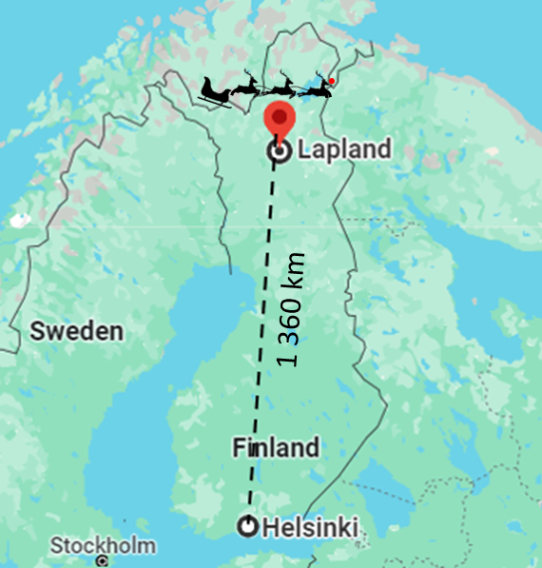
ADVENT – Day 9
On Christmas Eve, Santa’s sleigh is travelling from Lapland to Helsinki.
The distance is 1360 km and the sleigh travels at a constant speed of 200 mph.
How long will the journey take him?

Slide 27




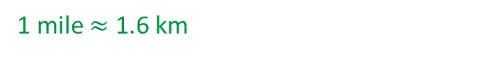
ADVENT – Day 9
On Christmas Eve, Santa’s sleigh is travelling from Lapland to Helsinki.
The distance is 1360 km and the sleigh travels at a constant speed of 200 mph.
How long will the journey take him?
1 mile $≈$ 1.6 km
200 mph $×$ 1.6 $=$ 320 km/h
Distance
Time $=$
Speed
1360
Time $=$
320
Time $=$ 4.25 hours or 4 hours 15 minutes

Slide 28
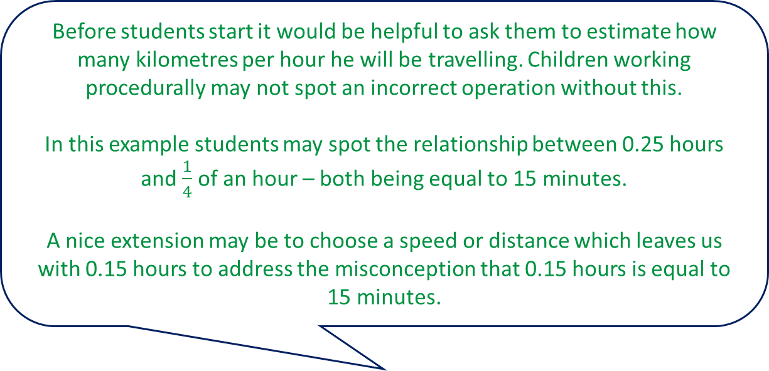
ADVENT – Day 9
Before students start it would be helpful to ask them to estimate how many kilometres per hour he will be travelling. Children working procedurally may not spot an incorrect operation without this.
In this example students may spot the relationship between 0.25 hours and $\frac{1}{4}$ of an hour – both being equal to 15 minutes.
A nice extension may be to choose a speed or distance which leaves us with 0.15 hours to address the misconception that 0.15 hours is equal to 15 minutes.

Slide 29
ADVENT – Day 10
8 Christmas presents have a mean mass of 1.3 kg.
Santa delivers a present with mass 0.4 kg to Jack.
He also delivers a present of mass 1.6 kg to Sam.
What is the total mass of the presents left?

Slide 30





ADVENT – Day 10
8 Christmas presents have a mean mass of 1.3 kg.
Santa delivers a present with mass 0.4 kg to Jack.
He also delivers a present of mass 1.6 kg to Sam.
What is the total mass of the presents left?
10.4 kg
Jack
Sam
0.4 kg
1.6 kg
8.4 kg
Mean $=$1.3 kg
1.3 $×$ 8 $=$ 10.4
10.4 $−$ (0.4 $+$ 1.6) $=$ 8.4
Total mass of all presents $=$10.4 kg
Total mass of the presents left $=$ 8.4 kg

Slide 31
ADVENT – Day 10
Representing this question visually can help students make connections with the information given and what they can work out from that.
Facilitate discussions with students using questions such as, “How do we calculate the mean?” and, “How could we find the total from that?”

Slide 32
ADVENT – Day 11
Rudoph is 7 years older than Cupid.
Next year he will be twice as old as Cupid.
How old is Rudolph now?

Slide 33


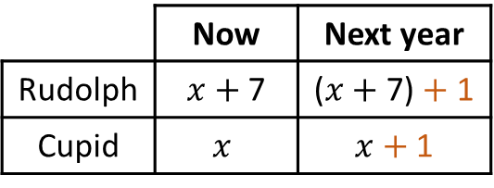



ADVENT – Day 11
Rudoph is 7 years older than Cupid.
Next year he will be twice as old as Cupid.
How old is Rudolph now?
Now
We do not know Cupid’s age: $x$
Rudolph is seven years older than Cupid: $x+$7
Next year
Cupid: $x+$ 1
Rudolph: ($x+$ 7) $+$1
As an equation
$(x+$ 7) $+$ 1 $=$ 2($x+$ 1)
$x=$ 6
How old is Rudolph now?
6 $+$ 7 $=$ 13 years old
Next year
 | Now | Next year
Rudolph | $x$ $+$ 7 | ($x$ $+$ 7) $+$ 1
Cupid | $$x$$ | $x$ $+$ 1
Rudolph is twice as old as Cupid
R
1
$$x$$
7
$=$ 13
C
1
$$x$$
7
$=$ 6

Slide 34
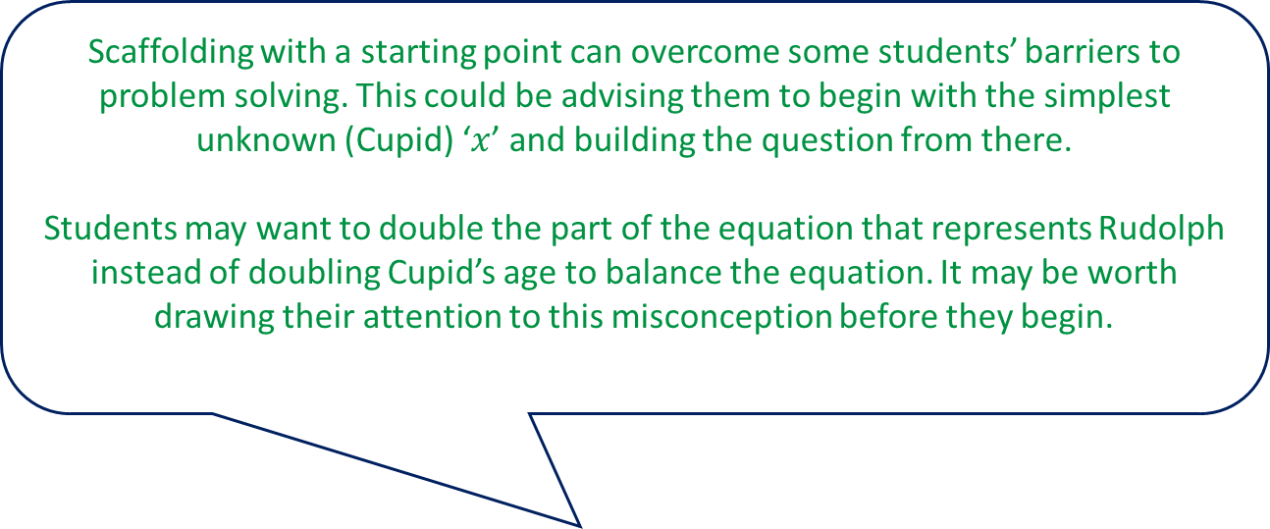
ADVENT – Day 11
Scaffolding with a starting point can overcome some students’ barriers to problem solving. This could be advising them to begin with the simplest unknown (Cupid) ‘$x$’ and building the question from there.
Students may want to double the part of the equation that represents Rudolph instead of doubling Cupid’s age to balance the equation. It may be worth drawing their attention to this misconception before they begin.

Slide 35
ADVENT – Day 12
Mr Smith wants to put fairy lights on the roof of his house for Christmas.
He hangs 7.5 m of blue fairy lights along the bottom edge.
He hangs 10.5 m of green fairy lights over the top two sides of the roof.
What are the lengths of the top two sides of the roof?
Not drawn to scale
10.5 m
7.5 m

Slide 36
















ADVENT – Day 12
Mr Smith wants to put fairy lights on the roof of his house for Christmas.
He hangs 7.5 m of blue fairy lights along the bottom edge.
He hangs 10.5 m of green fairy lights over the top two sides of the roof.
What are the lengths of the top two sides of the roof?
Not drawn to scale
$a^{2}+b^{2}=$ 7.5²
If $a=$4.5
$a+b=$ 10.5
$b=$ 10.5 $− a$
10.5 m
$b=$ 10.5 $−$4.5
$a^{2}+{\left(\text{10.5} −a\right)}^{2}=$ 7.5²
$b=$ 6
$a^{2}+$ 110.25 $−$ 21$a+a^{2}=$ 56.25
2$a^{2}−\text{21}a+$ 110.25 $=$ 56.25
If $a=$6
2$a^{2}−\text{21}a+$ 54 $=$ 0
$b=$ 10.5 $−$6
7.5 m
$($2$a−$9$)(a−$6$)=$ 0
$b=$ 4.5
$a=$4.5
$a=$6
The lengths of the top two sides are 4.5 m and 6 m.

Slide 37
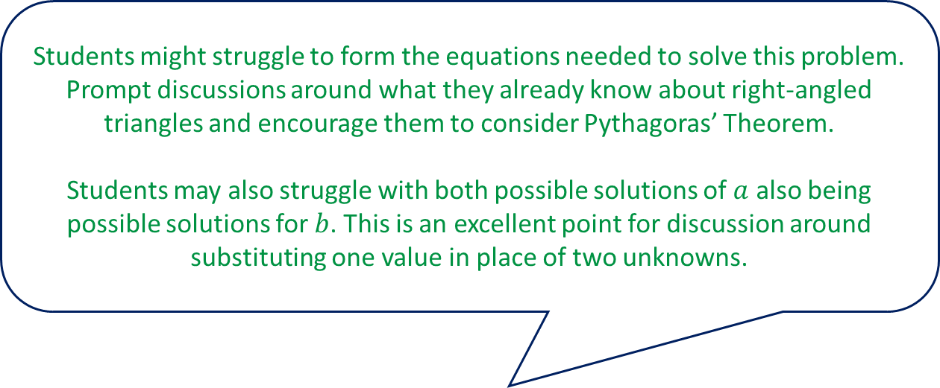
ADVENT – Day 12
Students might struggle to form the equations needed to solve this problem. Prompt discussions around what they already know about right-angled triangles and encourage them to consider Pythagoras’ Theorem.
Students may also struggle with both possible solutions of $a$ also being possible solutions for $b$. This is an excellent point for discussion around substituting one value in place of two unknowns.

Slide 38
ADVENT – Day 13
Santa has a sack full of gifts.
He has 5 toy cars, 7 dolls and 3 boxes of chocolates.
He selects two gifts at random without replacement.
What is the probability he will select two boxes of chocolates?

Slide 39













ADVENT – Day 13
Santa has a sack full of gifts.
He has 5 toy cars, 7 dolls and 3 boxes of chocolates.
He selects two gifts at random without replacement.
What is the probability he will select two boxes of chocolates?
1st selection
2nd selection
2nd selection
T
T
$$\frac{5}{14}$$
1st selection
$$\frac{5}{15}$$
$$\frac{7}{15}$$
D
$$\frac{7}{14}$$
$$\frac{3}{15}$$
$$×$$
$$\frac{2}{14}$$
$$=$$
$$\frac{6}{210}$$
$$=$$
$$\frac{1}{35}$$
D
$$\frac{3}{15}$$
$$\frac{2}{14}$$
C
C
There are 14 gifts to select, as you have not replaced the first gift selected.

Slide 40
ADVENT – Day 13
A good idea for students who struggle with conditional probability is to draw a probability tree.
Draw students’ attention to the denominator in the second selection allowing them to realise there is one less item than in the first selection.

Slide 41
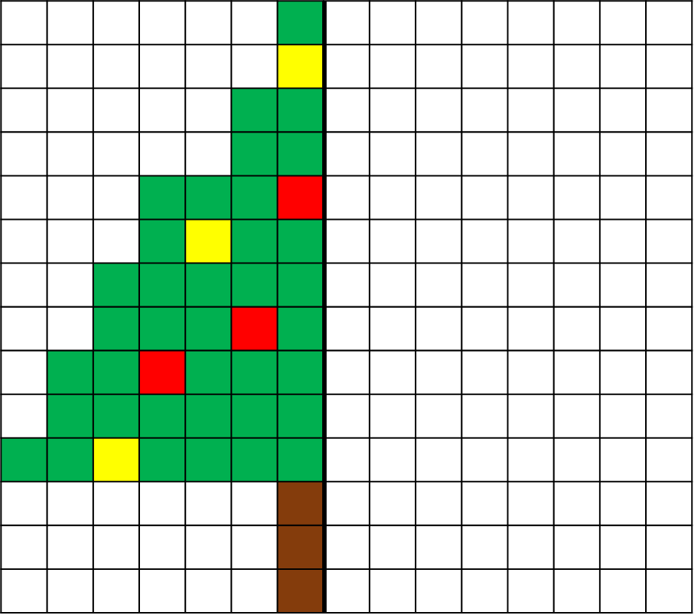
ADVENT – Day 14
Shade squares to reflect the shape in the mirror line.

Slide 42
ADVENT – Day 14
Shade squares to reflect the shape in the mirror line.

Slide 43
ADVENT – Day 14
Asking students to visualise the reflected image and consider what they know may minimise mistakes.
Counting squares is a useful technique to check accuracy.

Slide 44
ADVENT – Day 15
There are 120 people standing in line to see Santa at the Grotto.
For every three children there are two adults.
Santa has 85 toys to give to the children.
Does he have enough toys to give to the children or will his elves need to buy more?

Slide 45







ADVENT – Day 15
There are 120 people standing in line to see Santa at the Grotto.
For every three children there are two adults.
Santa has 85 toys to give to the children.
Does he have enough toys to give to the children or will his elves need to buy more?
72
children $:$ adults
children
24
24
24
3 $:$ 2
120
5 parts in total
adults
24
24
120 $÷$5 $=$24
120 $÷$ 5 $=$ 24
24 $×$3 $=$ 72
24 $×$ 3 $=$ 72
Yes Santa has enough toys.
85 $>$ 72
Yes Santa has enough toys.

Slide 46
ADVENT – Day 15
Drawing a bar model to represent the ratio can be a helpful tool to help students visualise the equal parts. This can help students focus on solving the problem and reduce the cognitive load.

Slide 47
ADVENT – Day 16
100 people were asked if they preferred Christmas pudding or mince pies.
56 of the people were male.
The rest were female.
23 females preferred mince pies.
59 people preferred Christmas pudding.
One of the people is chosen at random.
What is the probability that they are a male who prefers mince pies?

Slide 48
ADVENT – Day 16
100 people were asked if they preferred Christmas pudding or mince pies.
56 of the people were male.
The rest were female.
23 females preferred mince pies.
59 people preferred Christmas pudding.
One of the people is chosen at random.
What is the probability that they are a male who prefers mince pies?
 | Christmas puddings | Mince pies | Total
Male | 38 | 18 | 56
Female | 21 | 23 | 44
Total | 59 | 41 | 100
The probability of being a male who prefers mince pies is $\frac{18}{100}$ $=$ $\frac{9}{50}$

Slide 49
ADVENT – Day 16
On Day 13, we used a probability tree to represent conditional probability.
Here we use a two-way table to sort data.
Students need to be careful use the total number of males (56), but rather to select the males who like mince pies (18) out of the total number of people (100).
We can enable or extend students through giving them no table, a table with words, a table with words and 100 total (below) or a table with all given values (below).
 | Christmas puddings | Mince pies | Total
Male
Female
Total |  |  | 100
 | Christmas puddings | Mince pies | Total
Male |  |  | 56
Female |  | 23
Total | 59 |  | 100

